Slide 1
Budget Sales Analytics
Retail & Sales

Slide 2
Introduction
Welcome to our "Domain Sale" process, designed for seamless domain purchases. Sellers list domains at fixed prices in our Marketplace for instant buyer transactions. Extract and analyze sales, budgets, products, and customer data to create insightful, visually appealing dashboards and uncover key metrics.

Slide 3
Objective
To streamline the domain purchasing process by enabling instant transactions through a fixed-price Marketplace, and to provide tools for extracting and analyzing data on sales, budgets, products, and customers to create insightful dashboards.
Problem Statement​
The traditional domain purchasing process is often cumbersome, requiring direct negotiation between buyers and sellers. This can lead to delays and inefficiencies. Additionally, there is a need for a comprehensive system to extract and analyze various data metrics, such as sales, budgets, and customer information, to facilitate better decision-making and visualization through detailed dashboards.
​

Slide 4
KPIs (Key Performance Indicators)​
Sales Performance: Customer Metrics: Product Metrics:
Total Sales Revenue Customer Acquisition Rate Top-Selling Domains
Number of Domains Sold Customer Retention Rate Sales by Domain Category
Average Sale Price Average Customer Spend Domain Traffic Impact
Sale Price Variance Top Customers by Revenue Average Domain Age
Budget Metrics: Market Metrics:
Listed Price vs. Sale Price Market Share
Budget Utilization Rate Growth Rate
Price Competitiveness Customer Demographics

Slide 5
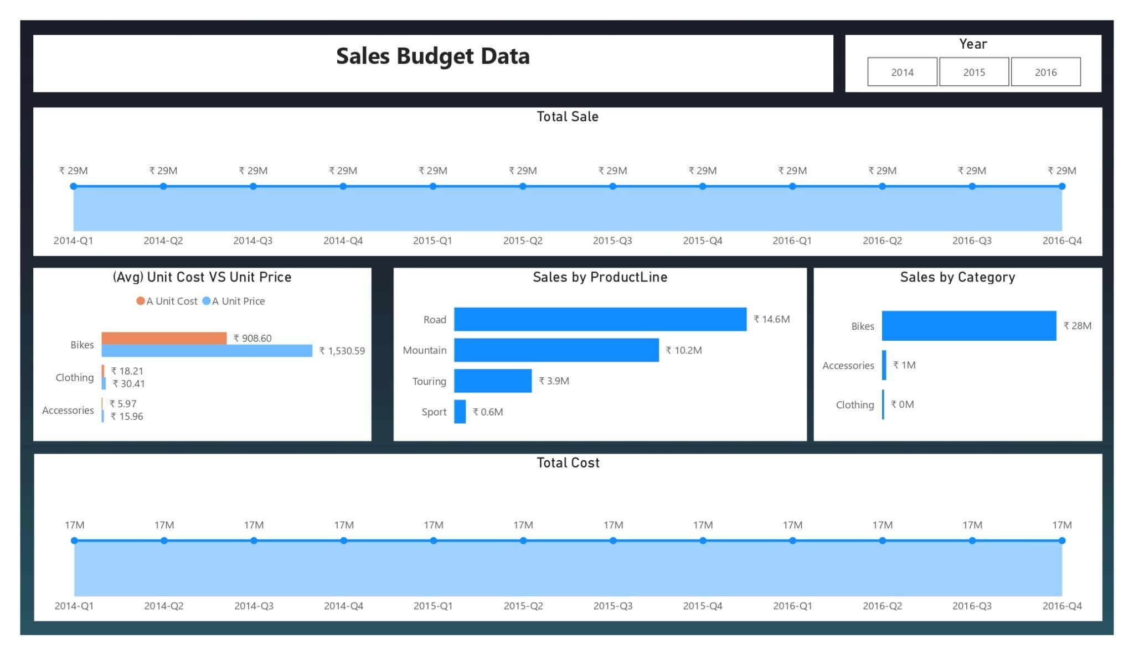
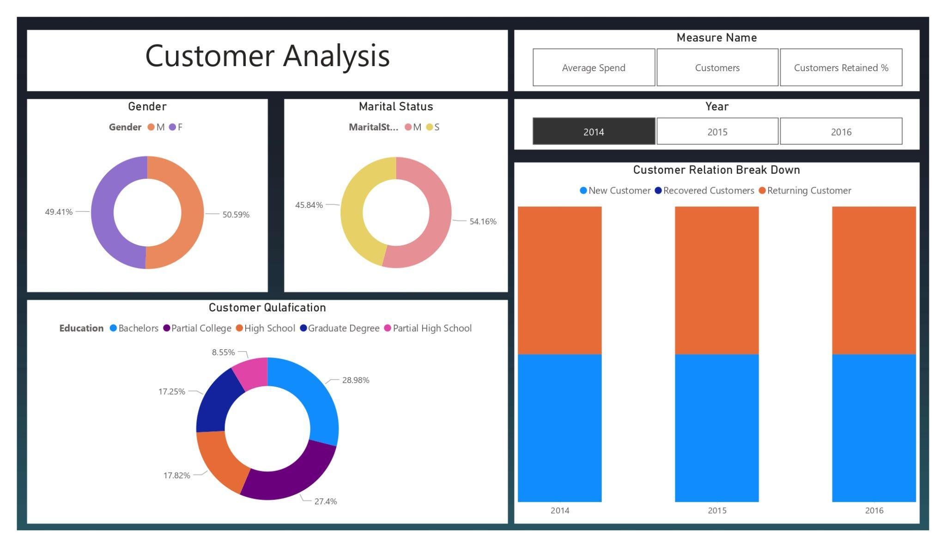
My Design

Slide 6
Benefit’s
1. Enhanced Sales Insights:
By tracking detailed sales data, the platform allows for precise revenue monitoring and performance analysis. Sellers can identify trends and patterns in domain sales, such as the most popular categories or the times of year when sales peak. This enables sellers to adjust their strategies, set competitive prices, and maximize profits. Furthermore, analyzing the variance between listed prices and actual sale prices provides valuable feedback for refining pricing strategies to better meet market demands.
2. Improved Customer Understanding:
The platform provides in-depth insights into customer behavior, acquisition, retention, and spending habits. By segmenting customers based on their purchasing history and demographics, businesses can tailor their marketing and sales efforts to specific groups. This personalized approach increases customer satisfaction and loyalty, ultimately driving repeat business. Additionally, understanding top customers and their preferences helps in designing targeted campaigns that are more likely to convert, leading to higher overall sales and customer retention rates.
3. Data-Driven Decision Making:
The use of interactive dashboards and advanced data visualization tools allows businesses to easily interpret complex data and derive actionable insights. Monitoring key performance indicators (KPIs) such as total sales revenue, average sale price, and market share provides a comprehensive overview of business health and performance. This data-driven approach facilitates informed decision-making, enabling businesses to quickly identify areas for improvement, capitalize on successful strategies, and maintain a competitive edge in the market.

Slide 7
Thank you

